Slide 1
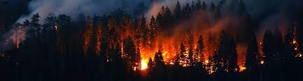
Wildfire Data Visualization
Team Kahn: Mike Pogatchnik, Patrick Sande, Kristen Wunderlich, Emily Jacobs, Karrin Connors

Slide 2
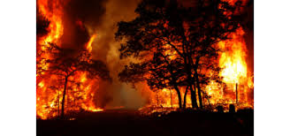
Project Requirements
Theme: Wildfires reported in California and Minnesota during a 25 year period, selecting three one-year periods with the range of the data (1992, 2002 and 2012).
Coding Approach
Data Munging Techniques
Final Visualizations

Slide 3
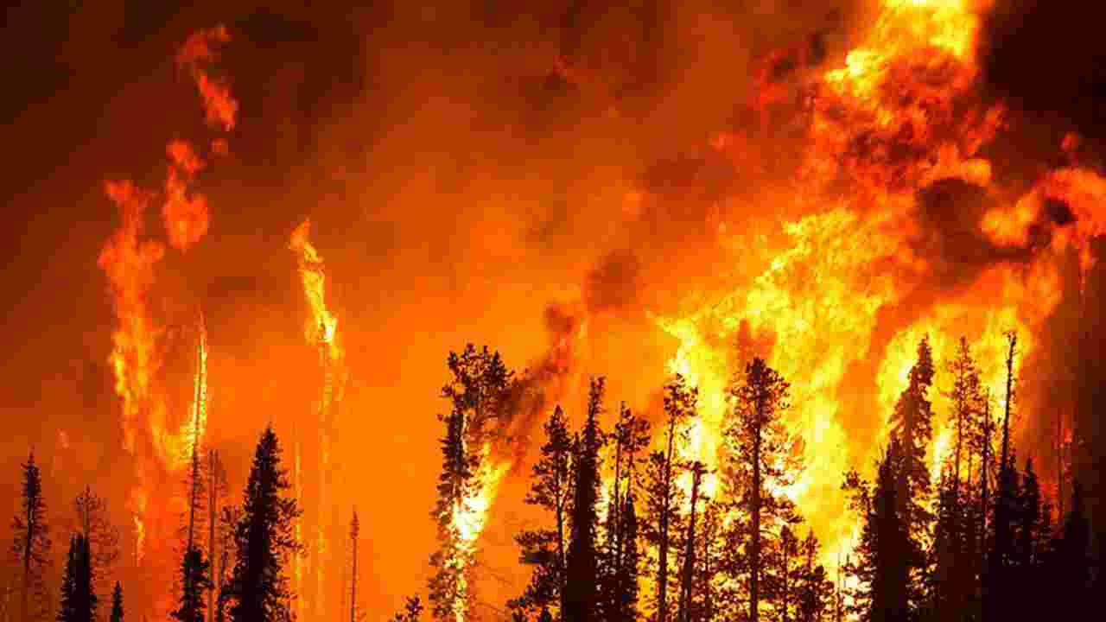
Data Set
Obtained sqlite file from Kaggle.com which contained nearly 2 M records
https://www.kaggle.com/rtatman/188-million-us-wildfires
Converted data to CSV and Imported to Excel to view data
Parsed data down to:
Location: Two states (CA and MN)
Time Period: 1992, 2002 and 2012
Converted data back to sqlite database

Slide 4
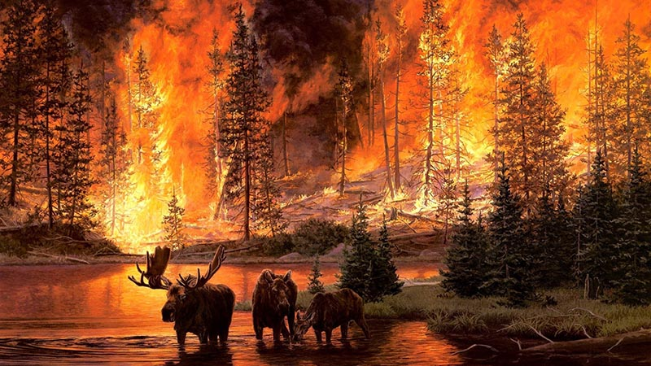
Libraries
HTML
D3
CSS
Javascript
Python
Flask
SQLite
Leaflet
Additional Javascript Library:
https://d3-legend.susielu.com/

Slide 5
Designed Project Plan
Base files created to support final visualization goals (Python, JavaScript, HTML and CSS)
Determined what connectors were required to facilitate communication between the files (i.e. Flask)
Each team member initially worked on individual components before merging project elements together
Discussed challenges and hurdles as a team to problem-solve

Slide 6
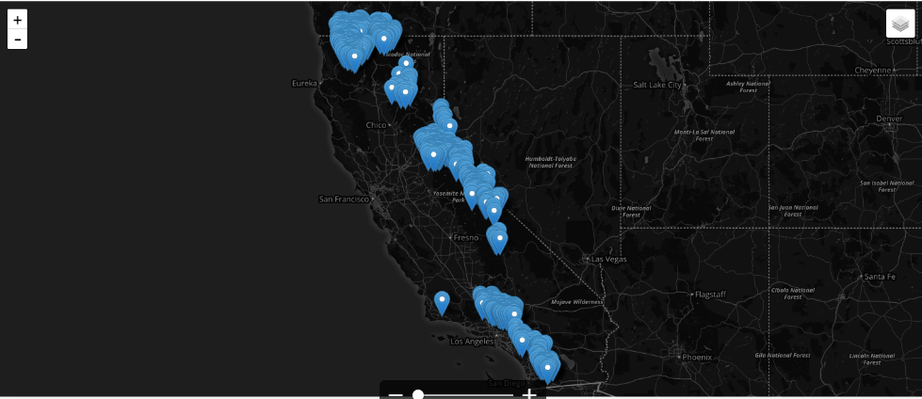
Early Visualization

Slide 7
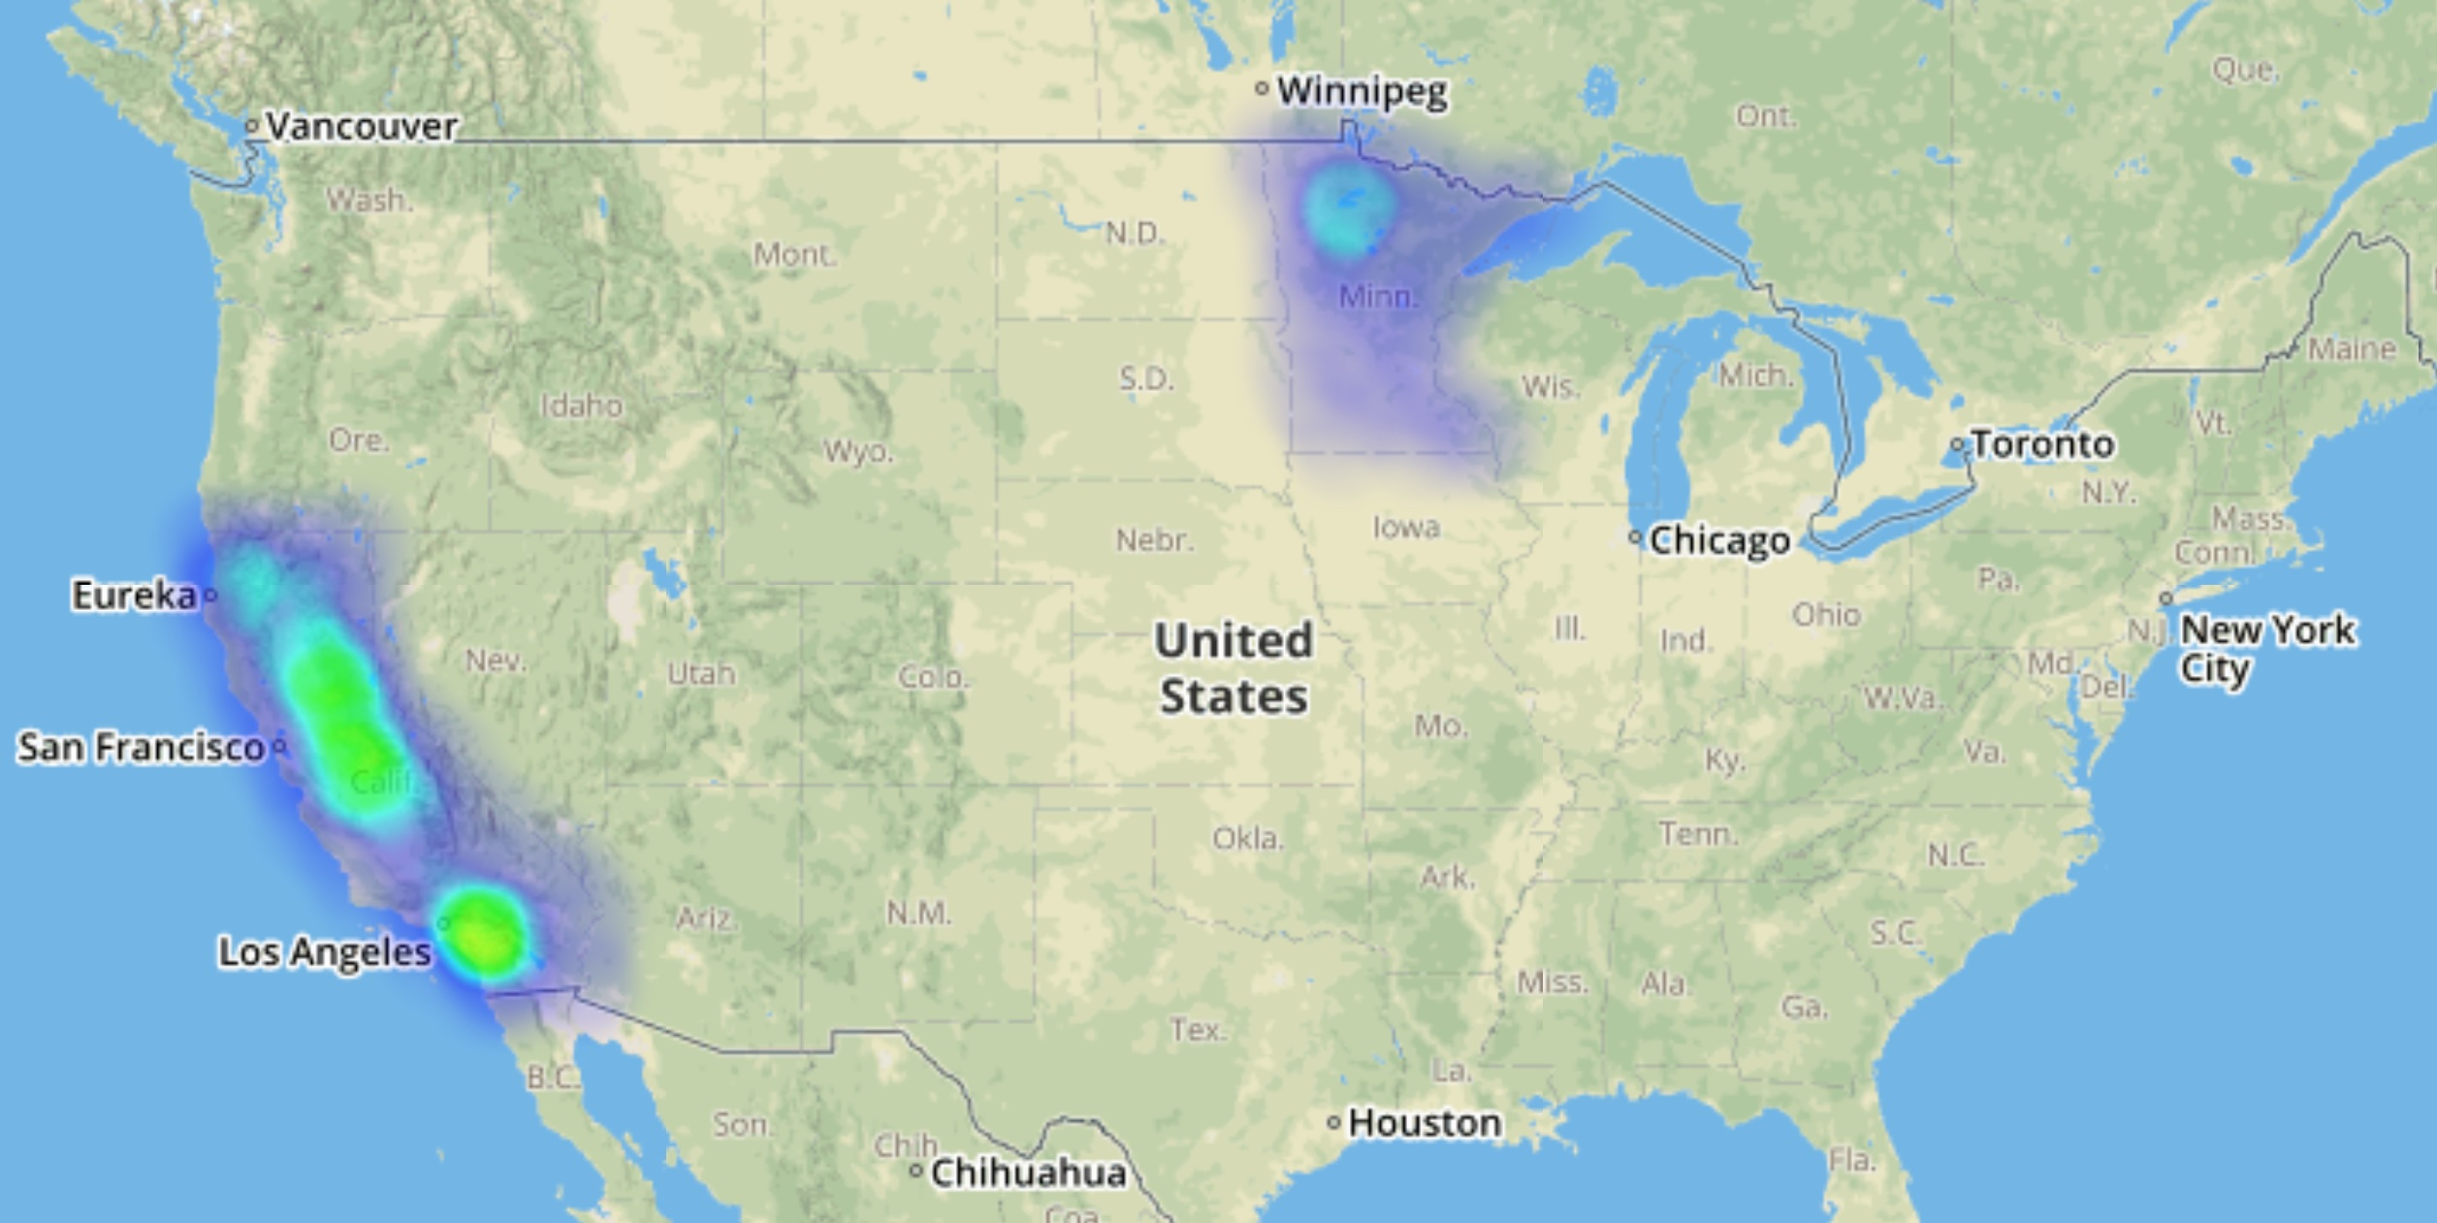
Comprehensive Heat Map Heatmap displaying wildfires present in California and Minnesota

